Slide 1
SecOps SPL
An alternative toolset for Security Operations
Release 2024-Q1 – An Overview

Slide 2
General Features
Essential functions for Teams working in
  SOC (Security Operations Center)
  CTA / CTI (/Cyber Threat Analytics / Intelligence)
  CSA (Cyber Security Architecture) and RM (Risk Mgmt)
  UCF (Use Case Factory)
Segragation of Functions and Access Rights for these Teams
Multi-tenancy for all functions
Definition of own Monitoring Targets
Integration of BAIT, KAIT, MITRE ATT&CK and DORA (future)
Staging (dev, test, prod) for Use Case Entwicklung
Integrated Use Case Testing (manual / automatic execution)
Highly standardised Use Cases
Comfortable UI for Activation / Deactivation of Use Cases, including their specific Staging
Welcomelisting of Alerts, freely definable
Automatical Grouping of similar Alerts, freely configurable
Automatical Closing of Alerts, based on own Rules
Continuously growing Use Case Library for these areas
  Windows, Linux, zOS, DB2, Oracle, MS-SQL, VPN, Cloud, Firewall and more
Dashboard-based Maintenance of central Lookup files
Extensive Reporting and Information Functions

Slide 3



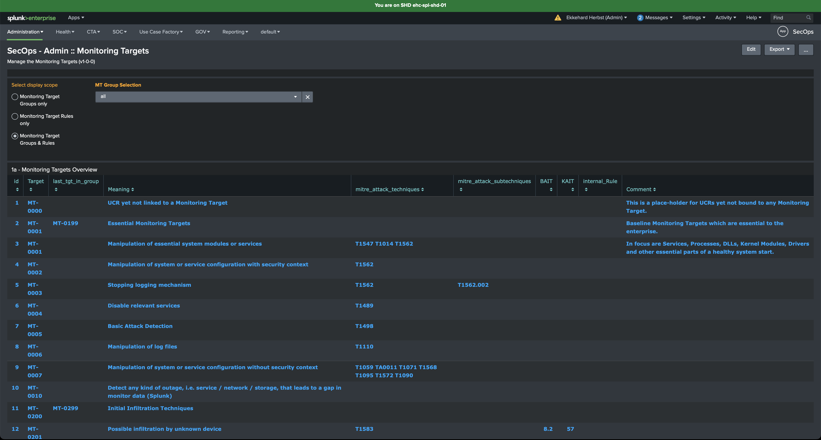
Functions for ... CSA and RM
Example: Administration of Monitoring Targets
z
Definition / Documentation of your specific Monitoring Targets
Assignment of Frameworks and Governmental Rules (BAIT, KAIT, DORA*, MITRE) to Monitoring Targets
Assignment of Use Cases to Monitoring Targets
* available in near future
Copyright ® 2024 Ekkehard Herbst Consulting

Slide 4
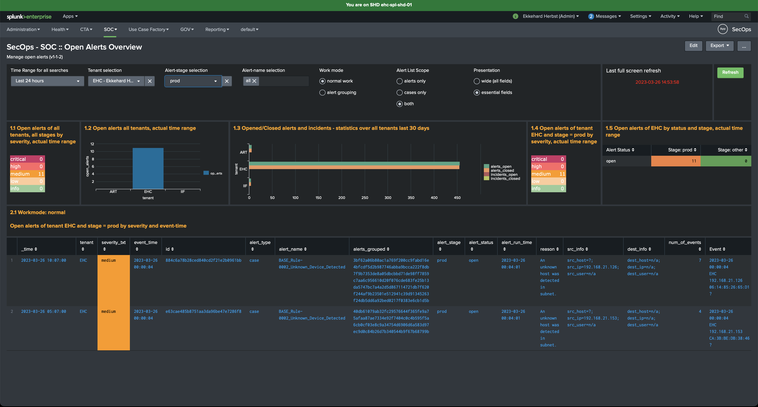
Functions for ... CTA and SOC
Example: SOC Overview of Open Alerts
z
Separation of Notable Events and Incidents
  Notable Events in SOC Overview
  Incidents in CTA Overview
Manual Grouping of Alerts (Notable Events) into Cases
Drilldown Searches ease Event Analysis
Varied Functions for Alert / Case Processing (next Slide)
Copyright ® 2024 Ekkehard Herbst Consulting

Slide 5
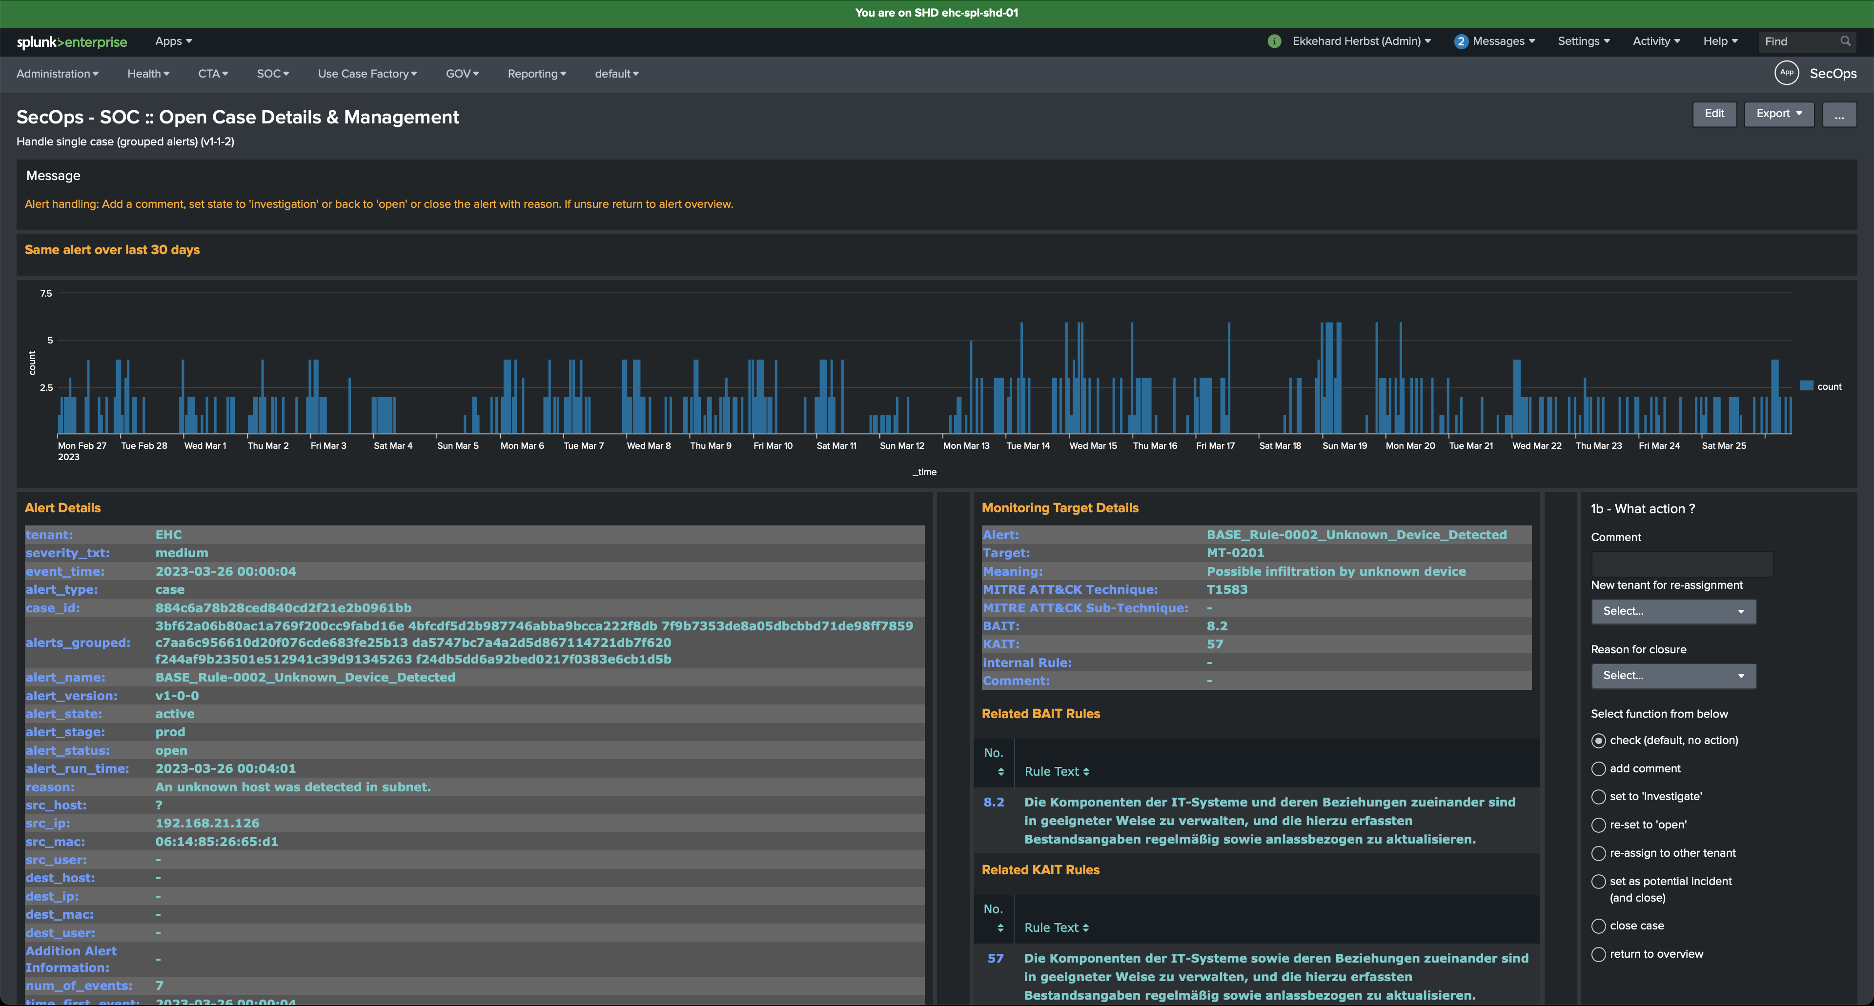
Functions for ... CTA and SOC
Example: Alert / Case Processing
z
Display of Alerts / Case and related Information
  Frequency of Appearance during last 30 days
  for Cases: all grouped alert_ids within a Case
  all detailed Data (Data Fields)
  assigned Monitoring Target
  Founding Governmental Rules / Security Frameworks
Functions to
  edit additional comments
  change the Alert‘s / Case‘s status
  mark Alert/Case as Incident
  Re-assign Alert‘s / Case‘s Tenant
  Close Alert / Case with substantiation
Copyright ® 2024 Ekkehard Herbst Consulting

Slide 6
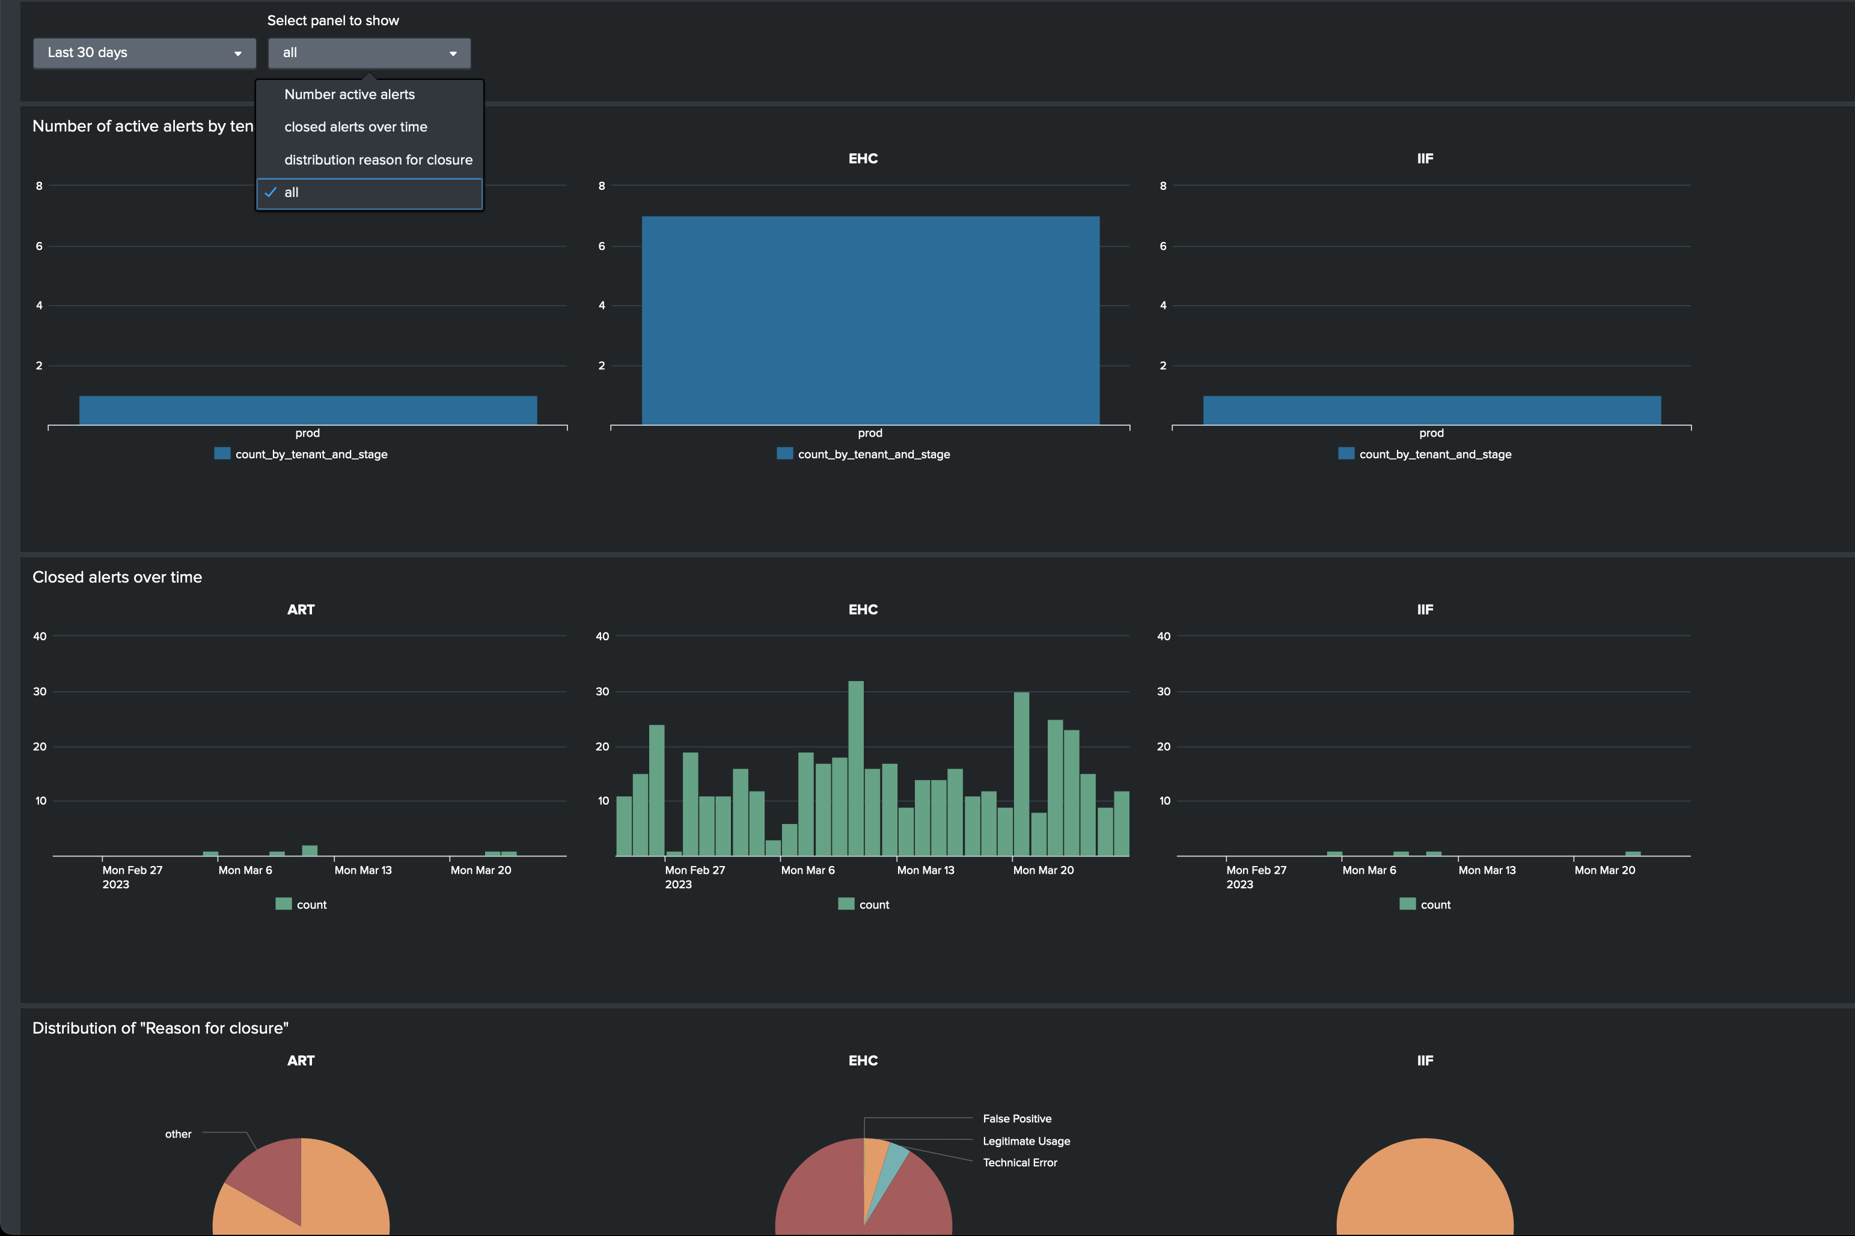
Reporting
Example: Overall Alert Statistics
z
Standard Reports in Dashboards
  Monitoring Targets
  Monitoring Targets and Use Cases
  Overall Alert Statistics (screenshot)
  Auto-closed Alerts
  Historical Alerts
  Alert Trigger Statistic
Copyright ® 2024 Ekkehard Herbst Consulting

Slide 7
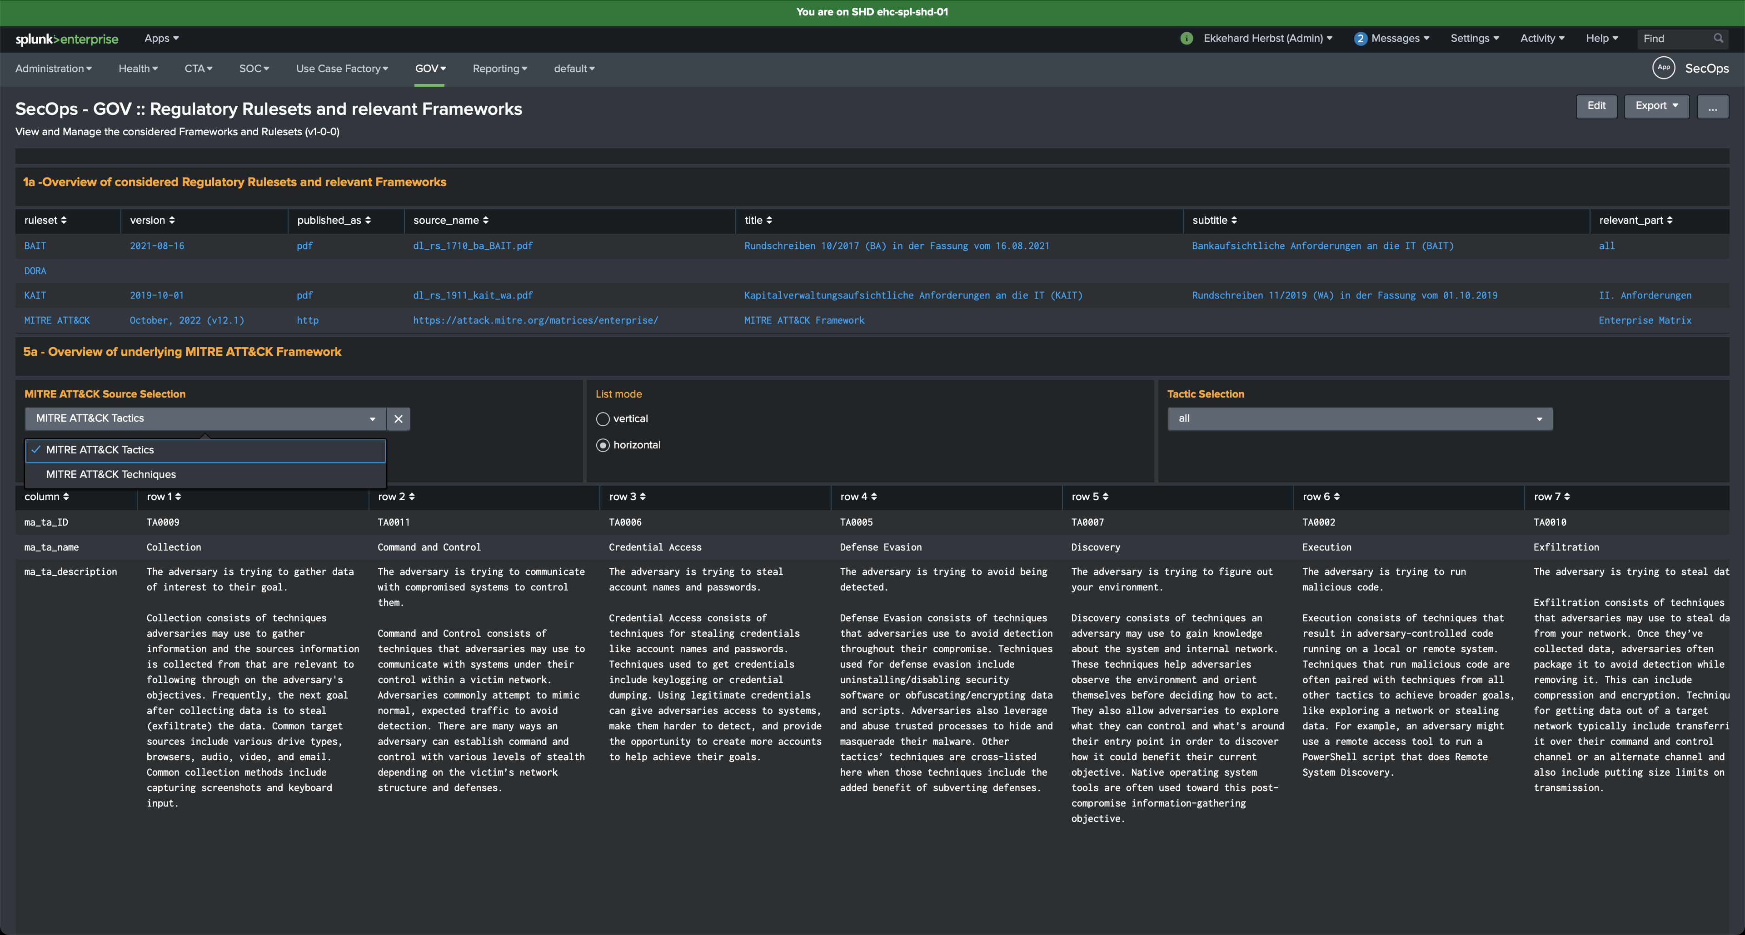
Integrated Frameworks and
Governmental Rules
z
Integrated Frameworks and Governmental Rules by now and near future
  BAIT
  KAIT
  MITRE ATT&CK (screenshot)
  DORA (near future)
Copyright ® 2024 Ekkehard Herbst Consulting

Slide 8
Road Map 2024
Planned Features of upcomming Releases in 2024
  active Cross-Referencing (optional)
    Evidence of usage of Searches, Dashboards, Panels, Macros
    Provides causing errors when modifying components without the knowledge of where they are used
    Better Time and Cost estimation based on facts
  Functional Extensions (regular)
    Enhancement of the Use Case Library
    Risk-base Approach: Integration of „Protection Requirement Class“ into Use Case Development
    Dynamical Prioritisation of Notable Events
    Correlation Searches for enhanced Threat Detection

